Slide 1
Financing Constraints & Corporate Investment S.M. Fazzari R.G. Hubbard B.C. Peterson (1988)
اگر این مقاله را نخوانده‌اید، این کلاس هیچ ارزش افزوده‌ای برای شما نخواهد داشت.

Slide 2
Content
Introductions
Hypothesis Basics
Theoretical Background
Internal Finance Vs. External Finance
Lemons
Financing Hierarchy
Models
results

Slide 3
Introduction
In perfect capital markets, a firm's investment decisions are independent of its financial condition.
External funds provide a perfect substitute for internal capital??
Financial factors affecting on investment?
Effects of IA on Internal OR External Financing?
COMMENTS?????

Slide 4
Hypothesis Basics
If the cost disadvantage of external finance is small, retention practices should reveal little or nothing about investment: firms will simply use external funds to smooth investment when internal finance fluctuates, regardless of their dividend policy.
If the cost disadvantage is significant, firms that retain and invest most of their income may have no low-cost source of investment finance, and their investment should be driven by fluctuations in cash flow.

Slide 5
Theoretical Background
Modigliani-Miller
Jorgenson and ... (neoclassical theory)
Mayer, Majluf
Greenwald, Stiglitz, Weiss
King and Auerbach
Akerlof

Slide 6
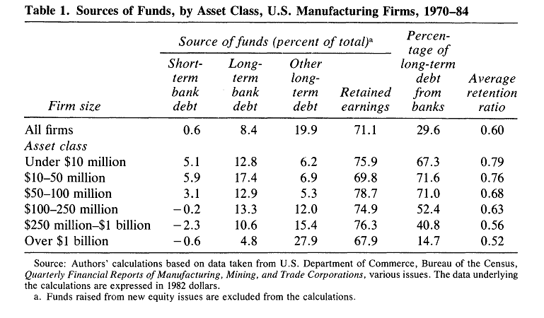
Raw Data
What is your idea about Depreciation?

Slide 7
Why internal finance is less costly than new share issues and debt finance?
Transaction Cost
Tax Advantages
Agency Problems
Cost of Financial Distress
Asymmetric Information
YOUR IDEA????

Slide 8
New Share Issues
r: cost of internal finance
s: cost of new share issues
_{ᶿ}: tax on dividends
c: tax on capital gains

Slide 9
Lemons
Lemon Problem…
Lemon Premium
Financing Hierarchy
q Model of Investment
Y: gross returns from assets in place
Y’: return from a new project
I: cost of the new investment
V: market value assigned to good firms and lemons
NEW SHARES WILL BE ISSUED ONLY IF:

Slide 10
Debt Finance
Agency Prblems
Managers’ Actions (NPV & Risk Issues)
Covenants
Covenants and fund availability
Fund availability and fund expense
Rise of interest rate and lenders’ Adverse Selection Problem (extra interest on unknown borrowers)
What about Heterogeneity?

Slide 11
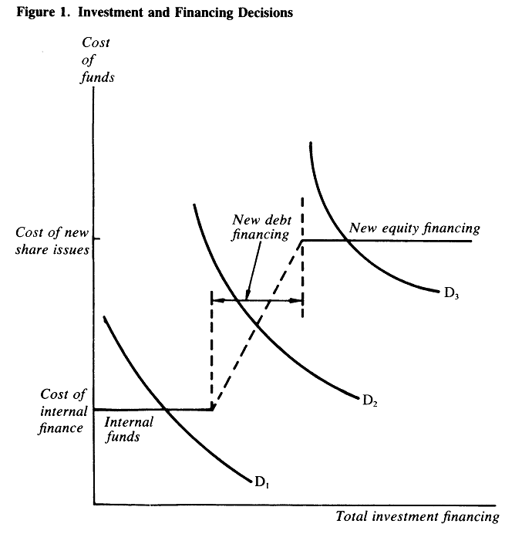
Financing Hierarchies
q and information asymmetry
q and new issuance

Slide 12
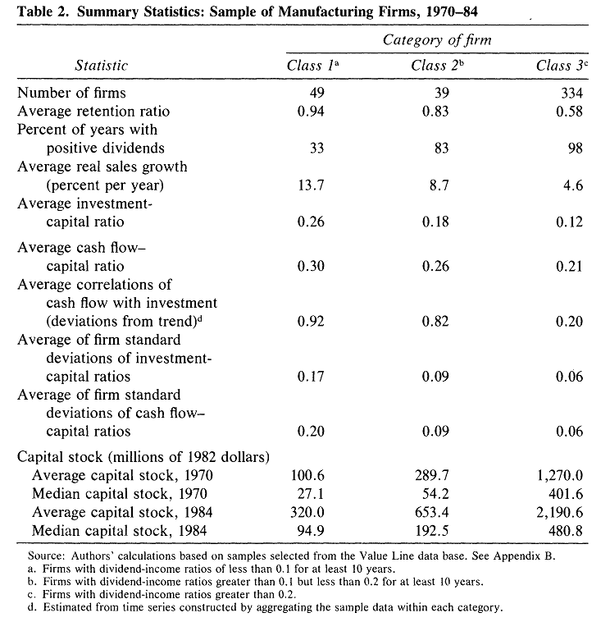
Data and firm categorizing

Slide 13
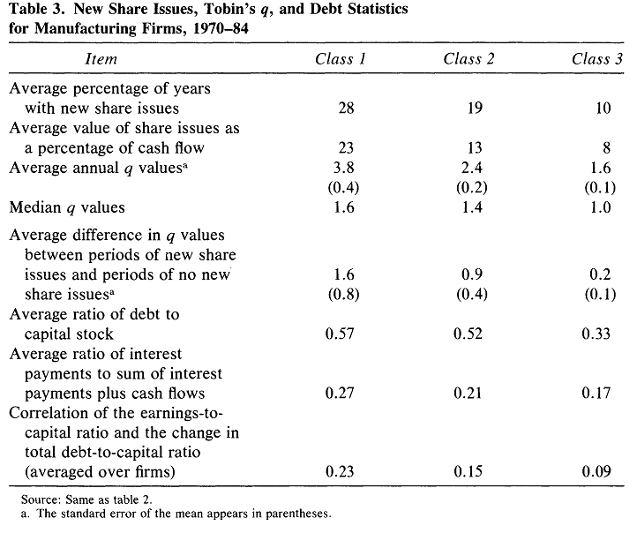
New issuance
Why?

Slide 14
Model

Slide 15
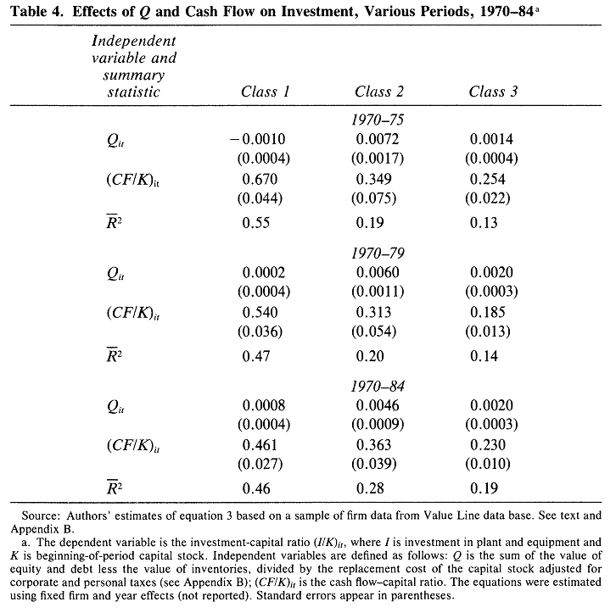
Q Model of investment

Slide 16
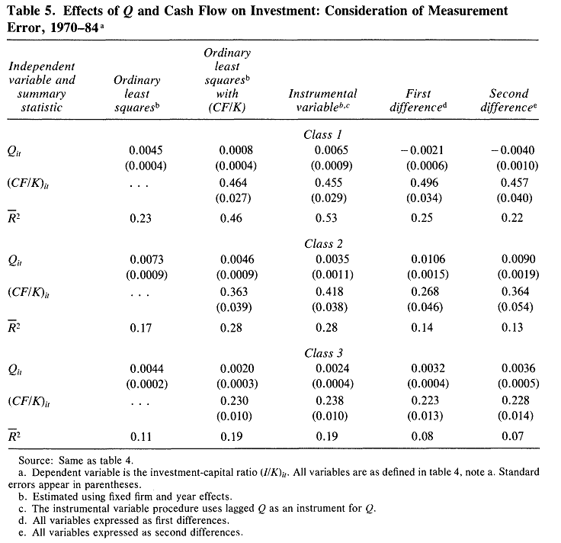
Robustness
Interpretation?

Slide 17
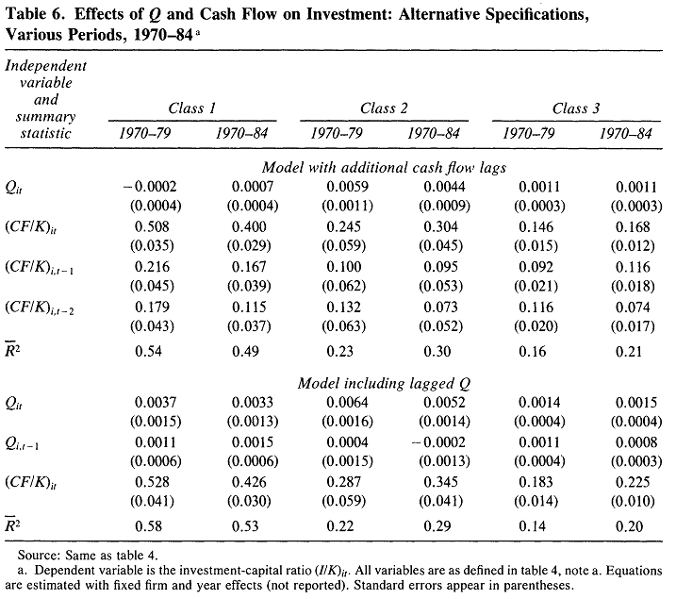
Alternative Specifications

Slide 18
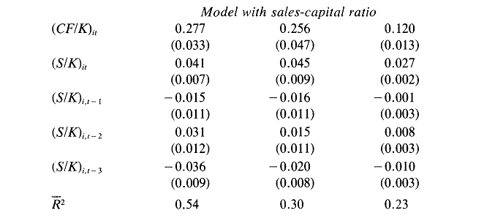
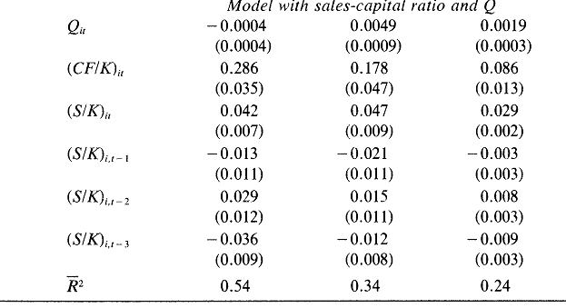
Accelerations Investments Demand Model

Slide 19
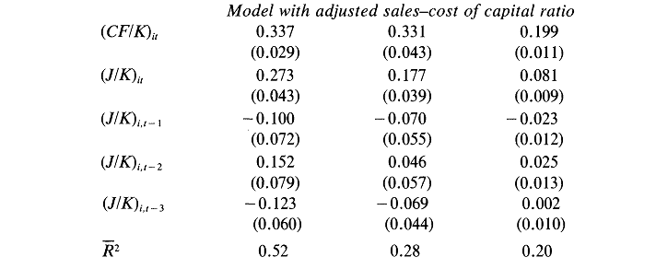
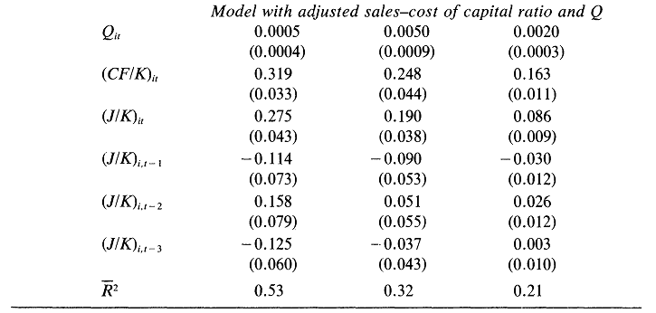
Neoclassical Investments Model

Slide 20
Thanks for your attention
Comments Or Questions…?
www.eslamibidgoli.com

